Slide 1
Canadian Bioinformatics Workshops
www.bioinformatics.ca

Slide 2

Module #: Title of Module
2

Slide 3


Module 4
Backgrounder in Statistical Methods

Slide 4
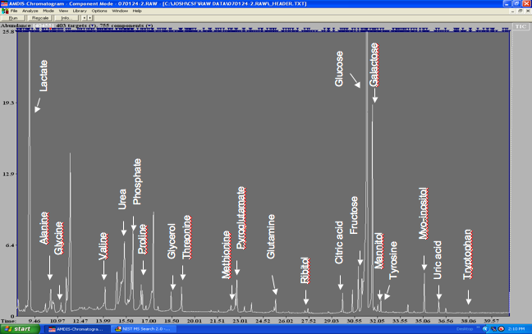
Yesterday
ppm
7
6
5
4
3
2
1

Slide 5
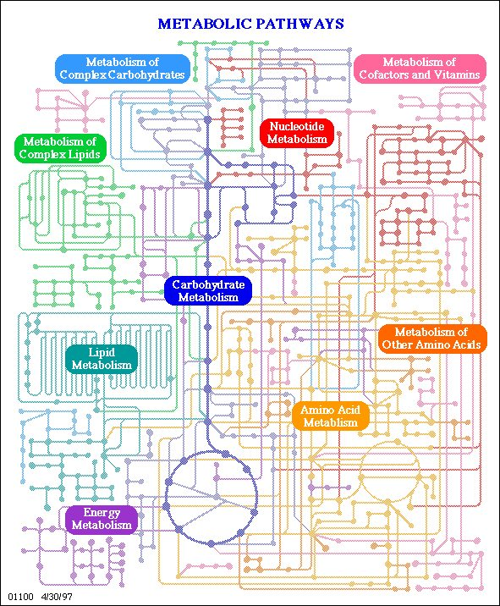
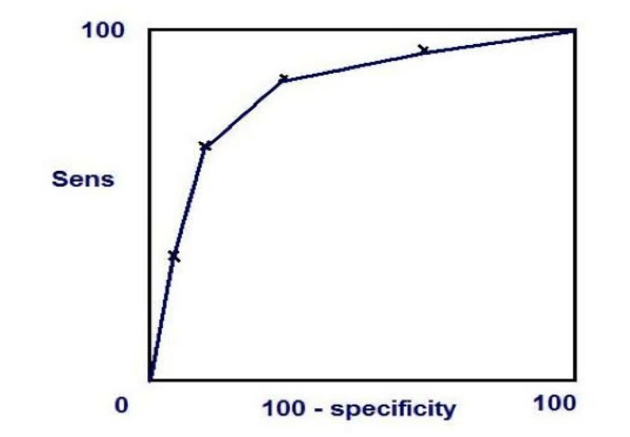
Today
25
PC2
20
15
ANIT
10
5
0
-5
Control
-10
-15
PAP
-20
PC1
-25
-30
-20
-10
0
10

Slide 6
Learning Objectives
Learn about basic concepts in ‘omics data analysis
Learn about p values calculation and interpretation
Learn about multivariate statistics (PCA and PLS-DA)
Learning about machine learning concepts (clustering, classification and performance evaluation,)

Slide 7
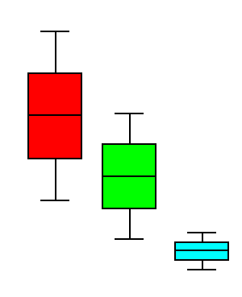
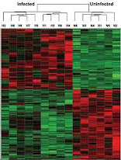
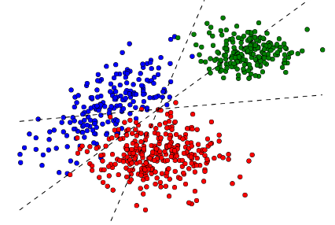
Omics Data Analysis (in a nutshell)
Platform-specific
Next-generation sequencing
Mass spectrometry
Data processing & QC
Comparison
Clustering
Classification
Statistical analysis & visualization
Functional interpretation
Omics-specific
Enrichment analysis
Pathway analysis
Unique functions
Field-specific
Dose-response
Biomarker analysis
Notes:
Clustering to group the samples.features by their internal similarities (unsupervised classification)
Classification is to group samples / features guided by their phenotype labels (supervised).

Slide 8
General Steps in Statistical Analysis
Read in data
Concentration table
Peak intensity table
Visualize the data (QC)
Boxplot
Scatterplot
Data Normalization
Log transformation
Auto-scaling (Z score)
Statistics & Machine Learning
Fold changes, T-tests, ANOVA
Multiple testing adjustment
PCA overview
Heatmap with clustering

Slide 9
Input & Output
Input: metabolomics data
X: a table containing numerical values
Concentrations, peak intensities
Y: meta-data: data about data
Class labels, experimental factors
Output: useful information
Significant features
Clustering patterns
Rules (for prediction)
Models …...

Slide 10
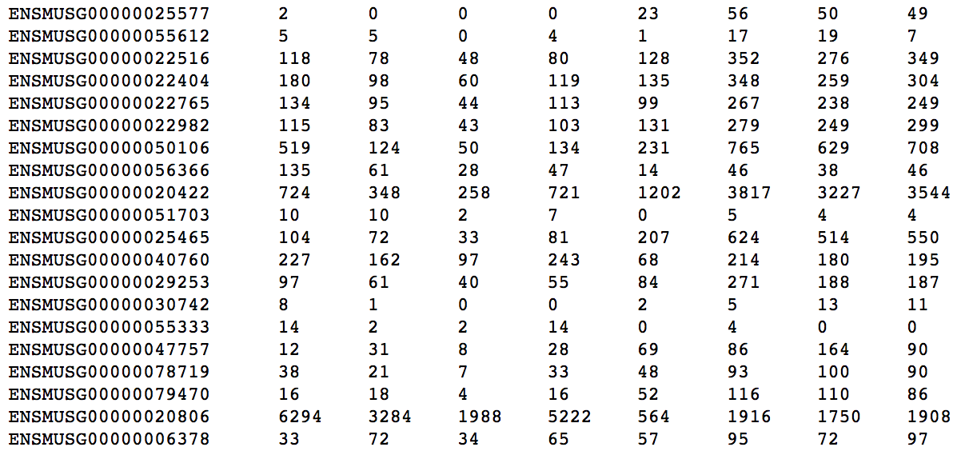
X: Quantitative Data
Continuous
Microarray intensities
Metabolite concentrations
Discrete
Read counts (RNAseq)
Need to be treated with different statistical models
Normal distribution
Poisson distribution

Slide 11
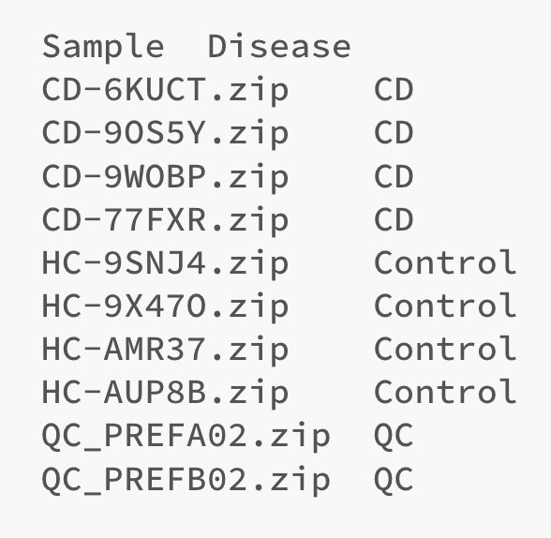
Y: Meta Data (data about X)
Binary data
0/1, Y/N, Case/Control
Nominal Data (> two groups)
Single = 1, Married = 2, Divorced = 3, Widowed = 4
Order is not important
Ordinal data
Time series
Disease severities
Dose responses

Slide 12
Put Together (X+Y)
Requested by most modules in MetaboAnalyst
Sample in rows
Sample in columns

Slide 13
Common Terms
Dimension
The number of variables (metabolites, peaks)
Univariate:
Measuring one variable per subject
Multivariate
Measuring many variables per subject
Omics data are usually high-dimensional data

Slide 14
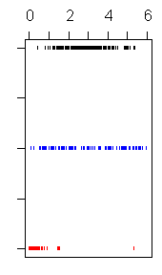
How Do We Describe the Data?
Central Tendency – center of the data location
Mean, Median, Mode
Variability – the spread of the data
Variance
Standard deviation
Relative standing – distribution of data within the spread
Quantiles
Range
IQR (inter-quantile range)

Slide 15
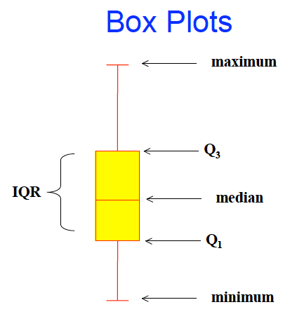
Box-and-whisker plot
The 1st quantile Q₁ is the value for which 25% of the observations are smaller and 75% are larger
Q₂ is the same as median (50% are smaller and 50% larger)
Q₃ is the value that only 25% of the observations are larger
Range is minimum to maximum

Slide 16
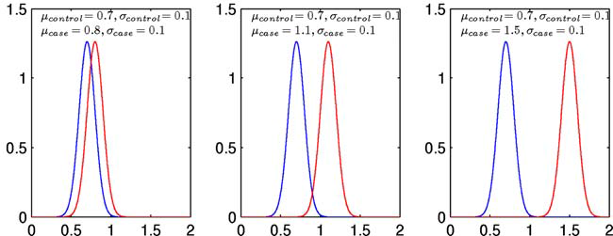
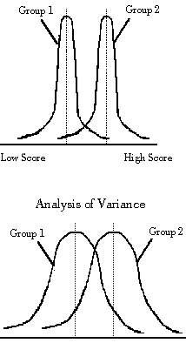
Mean vs. Variance
Most univariate tests compare the difference in the means, assuming equal variance

Slide 17
Normal Distribution
Almost any set of biological or physical measurements will display some some variation and these will almost always follow a Normal distribution
The larger the set of measurements, the more “normal” the curve
Minimum set of measurements to get a normal distribution is 30-40

Slide 18
A Bell Curve
# of each
Height
Also called a Gaussian or Normal Distribution

Slide 19
Other Distributions are Common
Unimodal Bimodal Skewed

Slide 20
Data Normalization
Most statistics models have been developed based on the assumption that the underlying data are ”normally” distributed
They work suboptimal when this assumption is not met (i.e. high false positives)
Solution - to transform data to close to model
➔ data normalization

Slide 21
Log Transformation
Skewed distribution
Normal distribution
exp’t B
linear scale
exp’t B
log
transformed

Slide 22
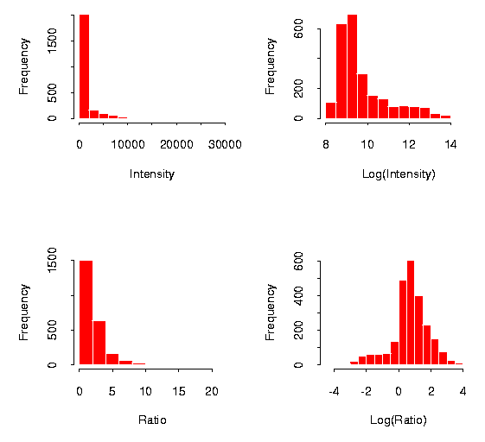
Log Transformation (Real Data)

Slide 23
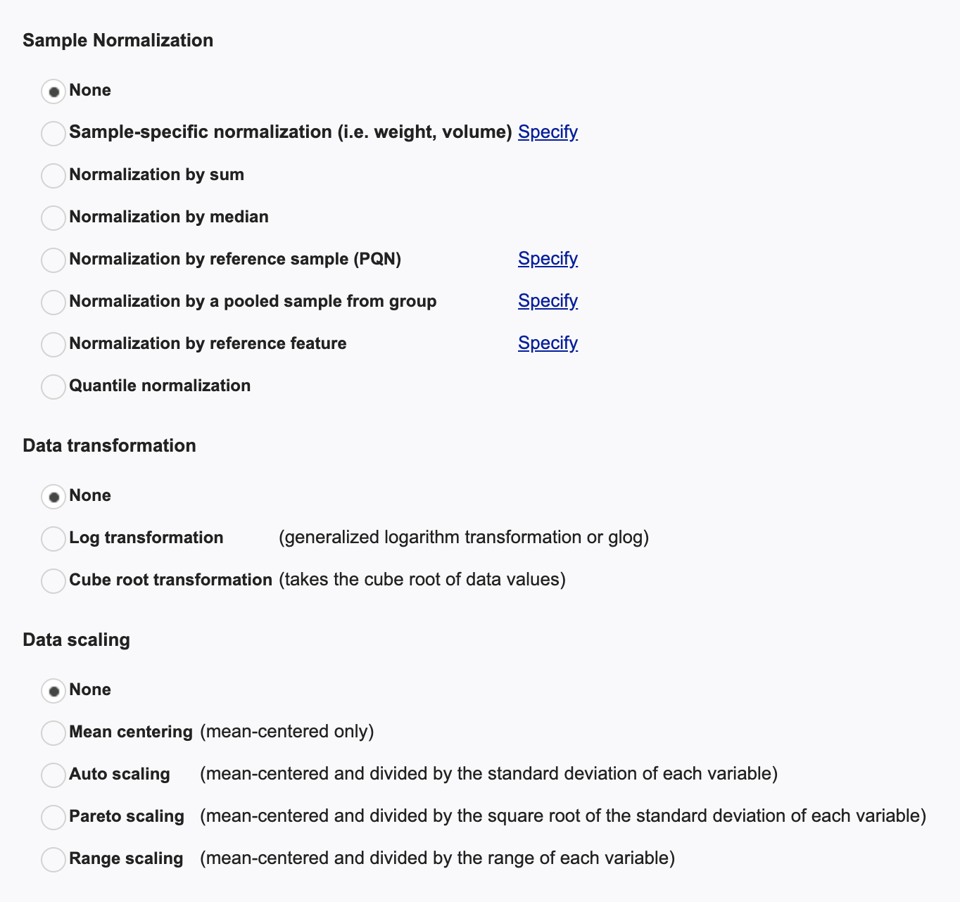
Data Normalization in MetaboAnalyst

Slide 24
Workflow of Omics Analysis
Read in data
Concentration table
Peak intensity table
Visualize the data
Boxplot
Scatterplot
Data Normalization
Log transformation
Auto-scaling (Z score)
Statistics & Machine Learning
Fold changes, T-tests, ANOVA
Multiple testing adjustment
PCA overview
Heatmap with clustering

Slide 25
Understanding P values

Slide 26
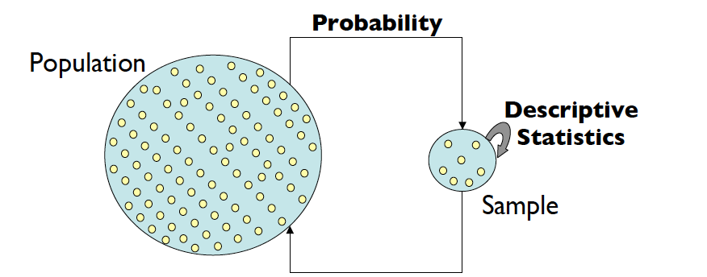
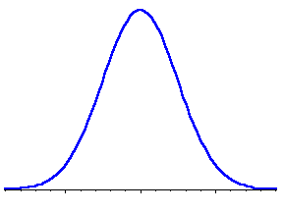
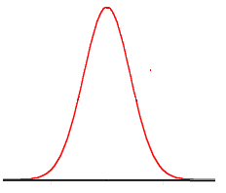
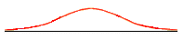
Uncertainties in Parameter Estimation

Slide 27
From Samples to Population
So how do we know whether the effect observed in our sample was genuine?
We don’t
Instead we use p values to indicate our level of uncertainty that our results represent a genuine effect present in the whole population
Notes:
Q
Explain that by genuine we mean that the observed effect was caused by a true effect present within the whole population
A

Slide 28
P values
P values = the probability that the observed result was obtained by chance
i.e. when the null hypothesis (H₀: i.e. no effect) is true
If that probability (p-value) is small, it suggests the observed result cannot be easily explained by chance
➔ How do we calculate a p value?
Notes:
P = Probability
this value tells us the probability that the observed result was obtained by chance
That there is no difference between the two groups
Each test result (e.g. t value) is associated with a particular p value
α level is set a priori
This is basically an acceptance level
Usually this is set to 0.05
But as I understand, α levels are usually much lower than this in fMRI
If p < α level then we reject the null hypothesis and accept the experimental hypothesis
- concluding that we are 95% certain that our experimental effect is genuine
If however, p > α level then we reject the experimental hypothesis and accept the null hypothesis
- that there was no sig diff in brain activation levels between the two conditions

Slide 29
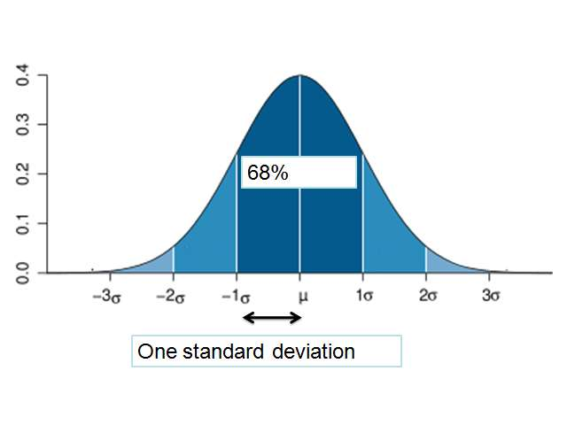
Distribution is known
99%
95%

Slide 30
Empirical P-values
Previously mentioned p-values are based on well defined models
Gaussian distributions, Poisson distribution
What if we don’t know the distribution?
The only thing we know is that the data does not follow a normal distribution
Poor performance using a model based on normal distribution
We can find out the null distribution from the data itself, then calculate the p-value
Also known as empirical p-values

Slide 31
Basic Principle
Under the null hypothesis (H₀), all data comes from the same distribution
We calculate our statistic, such as the mean difference, from the original data
We then shuffle the data with respect to group labels and recalculate the statistic (mean difference)
group labels do not matter under H₀
Repeat step 3 multiple times
Find out where our statistic lies in comparison to the null distribution

Slide 32
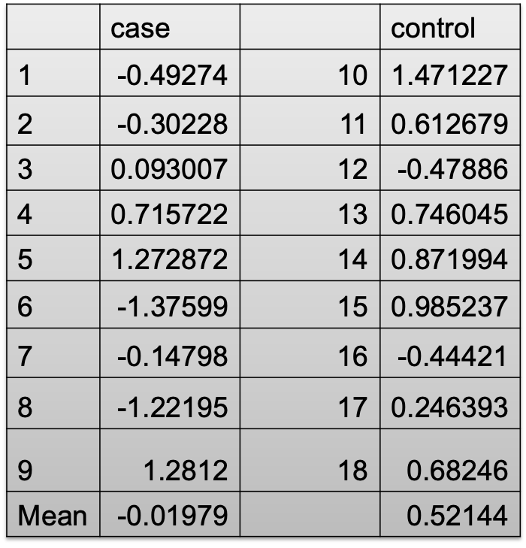
A Simple Example
To find out whether there is a mean difference between case vs. control
Mean difference .541

Slide 33
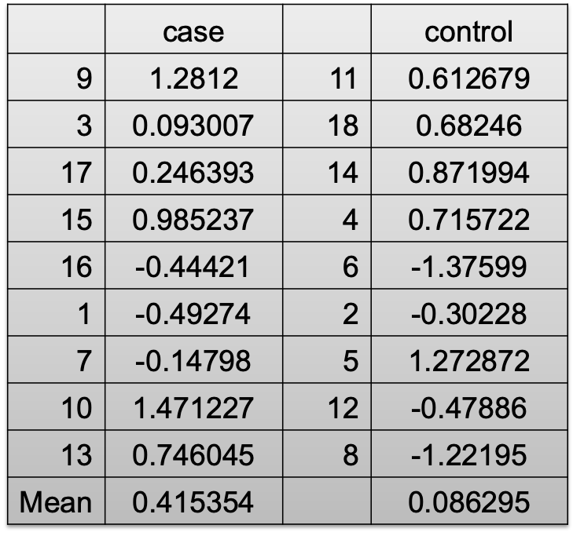
Permutation One
Note how the different labels have been swapped for the permutation
Mean difference = .329

Slide 34
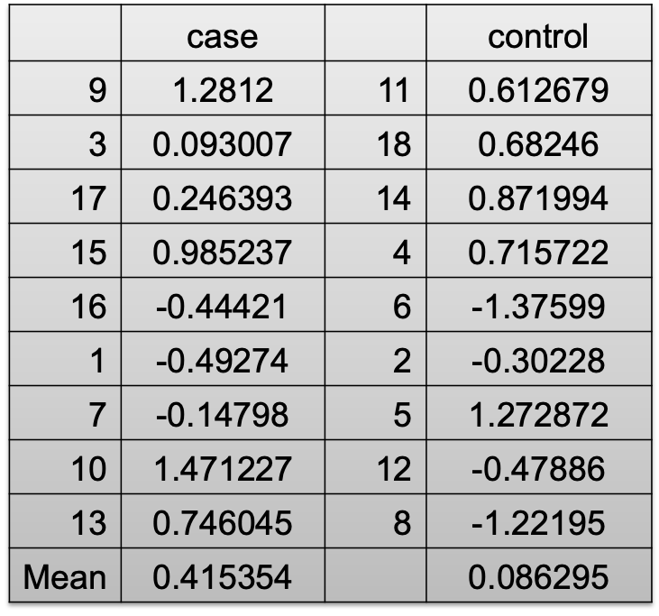

Permutations

Slide 35
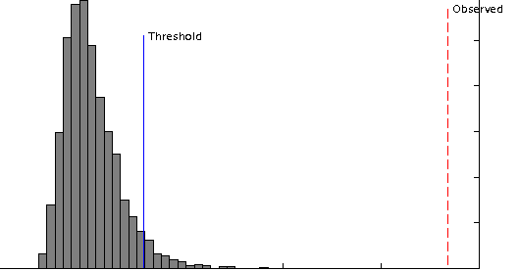
Compute Empirical P-value
In 1000 times permutations
There are three times the permuted data given large difference
p = 0.003 (this is the chance under null hypothesis)
If none of the permuted mean difference is bigger than the original one ➔ p < 0.001 or (1/1001) # prevent p-value equal to zero

Slide 36
General Advantages
Does not rely on distributional assumptions
Corrects for hidden correlation
Disadvantage?
Need relatively large number of samples
Computationally intensive

Slide 37
Multiple Testing Issues

Slide 38
Multiple Testing Issues
Omics yields high-dimensional data
100s to 10,000s of variables
Lots of hypothesis tests, with each one we accept a small chance
Performing T-tests on typical metabolomic data might result in performing 10000 separate hypothesis tests. If we use a standard p value cut-off of 0.05, we would see 500 (10000*0.05) genes to be deemed “significant” by chance alone

Slide 39
Multiple Testing Correction (I)
Family Wise Error Rate (FWER) - e.g. Bonferroni corrections
Corrected P-value= p-value * n (number of genes in test) <0.05. If testing 1000 genes at a time, the corrected p-value is 0.00005 (0.05/1000).
False Discovery Rate (FDR) - e.g. Benjamini-Hochberg
A FDR of 0.05 means that 5% among the significant metabolites are expected to be false positives

Slide 40
High-dimensional Data
So far, our analyses are dealing with a single variable (i.e. univariate analysis)
T-tests: one variable, two groups
ANOVA: one variable, > 2 groups
First analyze a single variable, and then apply the procedure to all variables, finally do multiple test adjustment
Visualization are limited to three dimensions
How can we analyze & visualize these high-dimensional data?

Slide 41
Machine Learning & Multivariate Statistics

Slide 42
The Challenges
Most statistical methods have been developed before the coming of the omics era
Most statistical methods are designed for single or very few variables
T-tests, ANOVA
Linear/logistic regression
These methods assume there are more samples (n) than the number of variables (p) (i.e. n > p) for parameter estimation
In omics data, n << p

Slide 43
The Practice
Classical multivariate statistics requires more complex, multidimensional analyses or dimensional reduction methods
Hard to use, hard to understand
Omics data analyses borrow a lot from several other fields
Pattern recognition / machine learning
Dimension reduction
Chemometrics

Slide 44
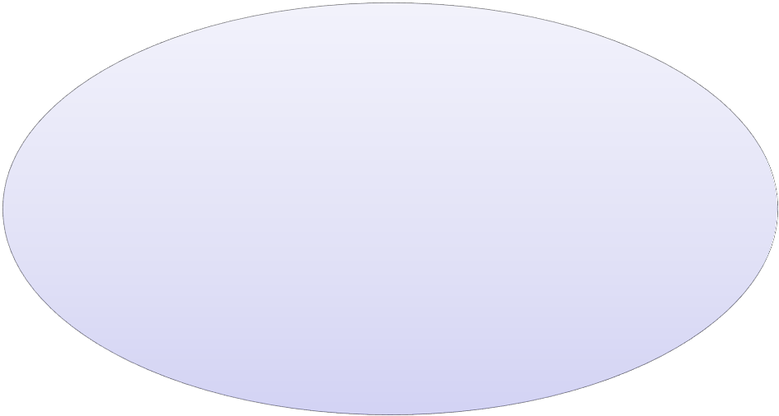
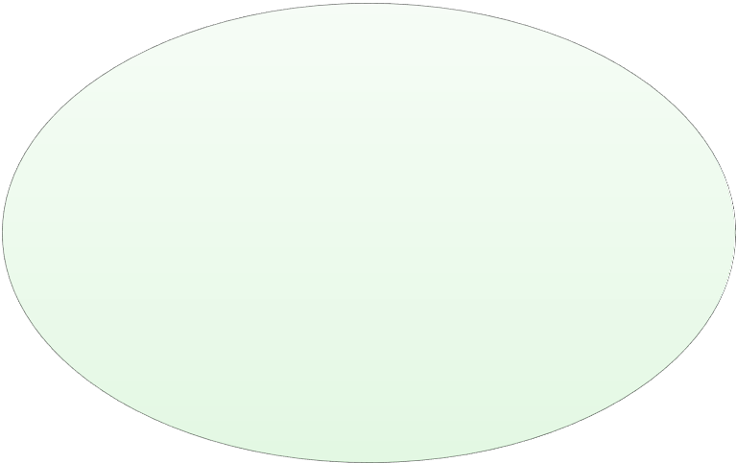
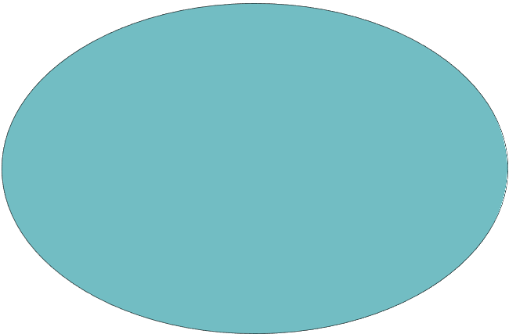
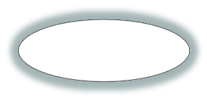

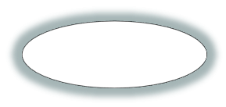
Key Areas in Data Science
Artificial Intelligence
Hypothesis Testing
Clustering
Classification
Statistics
Regression
Parameter Estimation

Slide 45
Pattern Recognition / Machine Learning
Focus on “patterns/groups” instead of individual features
Unsupervised learning: explore the data to find some intrinsic structures in them Disregard whether they are related to the class labels or not)
These patterns can be used to understand the key information within the data itself
Supervised learning: discover patterns in the data that relate data attributes with related to a target (class) attribute.
These patterns can be utilized to predict the values of the target attribute in future data instances

Slide 46
Unsupervised Learning Methods for High-dimensional Data
Clustering
Organize the 1000s of variables into blocks
Variables in each block are more homogenous, and treat these blocks as a unit
Dimension reduction
Reduce the high-dimensional data into low-dimension i.e. from 1000s of variables to 2 ~ 3 variables
Principal component analysis (PCA)

Slide 47
Clustering
Definition - a process by which objects that are logically similar in characteristics are grouped together
A method to measure similarity (a similarity matrix) or dissimilarity (a dissimilarity coefficient) between objects
A threshold value with which to decide whether an object belongs with a cluster
A way of measuring the “distance” between two clusters

Slide 48
Two Common Clustering Algorithms
K-means or Partitioning Methods - divides a set of N objects into M clusters -- with or without overlap
Hierarchical Methods - produces a set of nested clusters in which each pair of objects is progressively nested into a larger cluster until only one cluster remains

Slide 49
Hierarchical Clustering
Find the two closest objects and merge them into a cluster
Find and merge the next two closest objects (or an object and a cluster, or two clusters) using some similarity measure and a predefined threshold
If more than one cluster remains return to step 2 until finished

Slide 50
Key Parameters
Calculate the similarity between all possible combinations of two profiles
Similarity between samples
Similarity between clusters
Two most similar clusters are grouped together to form a new cluster
Calculate the similarity between the new cluster and all remaining clusters.

Slide 51
K-means clustering
Randomly chooses k observations from the dataset and uses these as the initial means
For the next object calculate the similarity to each existing centroid
If the similarity is greater than a threshold add the object to the existing cluster and re-compute the centroid, else use the object to start new cluster
Return to step 2 and repeat until done

Slide 52
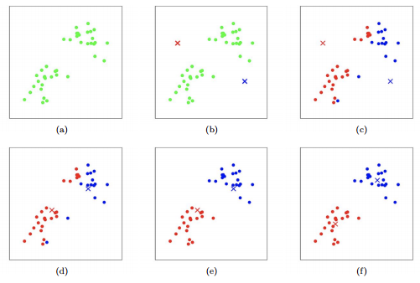
K-means Clustering
K = 2

Slide 53
Similarity Measurements
Euclidean Distance: Absolute difference

Slide 54
Similarity Measurements
Pearson Correlation: Trend similarity
+1 ≥ Pearson Correlation ≥ – 1

Slide 55
Clustering
Single Linkage
Dissimilarity between two clusters = Minimum dissimilarity between the members of two clusters
+
+
C₂
C₁
Tend to generate “long chains”

Slide 56
Clustering
Complete Linkage
Dissimilarity between two clusters = Maximum dissimilarity between the members of two clusters
+
+
C₂
C₁
Tend to generate “clumps”

Slide 57
Clustering
Average Group Linkage
Dissimilarity between two clusters = Distance between two cluster means.
+
+
C₂
C₁

Slide 58
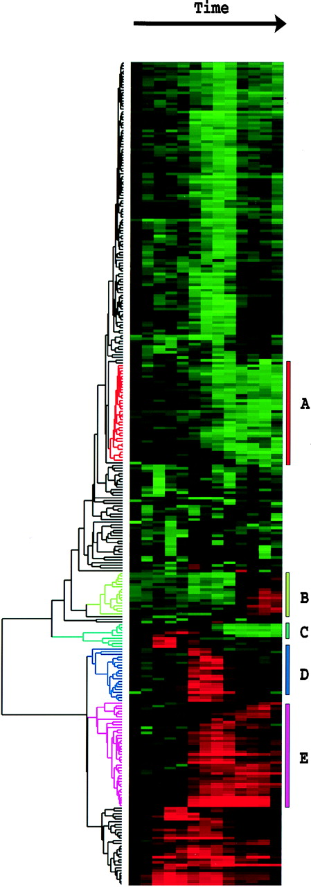
Hierarchical Clustering & Heatmaps
A
A
A
B
B
C
C
D
B
E
Find 2 most
similar metabolite
expression levels
or curves
Find the next
closest pair
of levels or
curves
F
Iterate

Slide 59
Principal Component Analysis (PCA)
Project high-dimensional data into lower dimensions that capture the most variance of the data
Assumption:
Main directions of variance
≈ major data characteristics

Slide 60
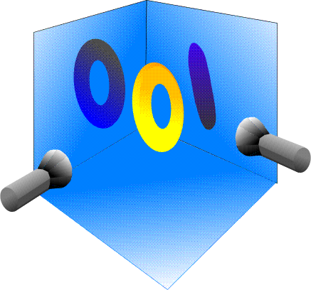
Visualizing PCA
PCA of a “bagel”
One projection produces a weiner (hotdog)
Another projection produces an “O”
The “O” projection captures most of the variation and has the largest eigenvector (PC1)
The weiner projection is PC2 and gives depth info

Slide 61
PCA - The Details
PCA involves the calculation of the eigenvalue (singular value) decomposition of a data covariance matrix
PCA is an orthogonal linear transformation
PCA transforms data to a new coordinate system so that the greatest variance of the data comes to lie on the first coordinate (1st PC), the second greatest variance on the 2nd PC etc.
x₁ x₂ x₃, … variables ……. x_{n}
t₁ t₂ ….. t_{m}
s₁ s₂ s₃… samples. s_{k}
p₁
p₂
p_{k}
Scores = t
(eigen vectors
uncorrelated
orthogonal)
…..
Loadings = p
Scores = Loadings x data
t₁ = p₁x₁ + p₂x₂ + p₃x₃ + … + p_{n}x_{n}

Slide 62
Principal Components Analysis On:
Covariance Matrix:
Variables must be in same units
Emphasizes variables with most variance
Correlation Matrix:
Variables are standardized (mean 0.0, SD 1.0)
Variables can be in different units
All variables have same impact on analysis

Slide 63
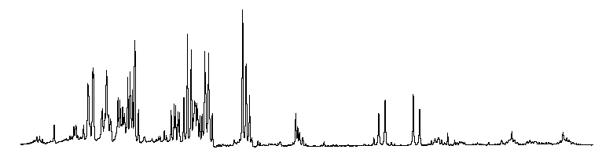
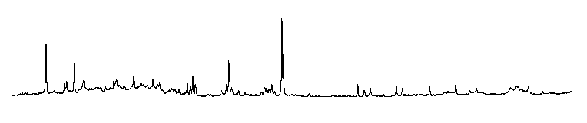
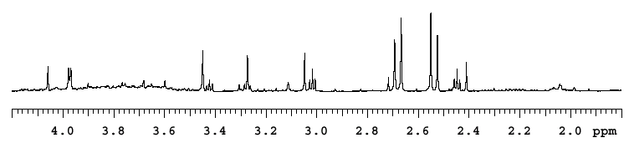
Widely Used in Metabolomics
Hundreds of peaks 2 components
25
PC2
PAP
20
15
ANIT
10
5
ANIT
0
-5
-10
Control
-15
PAP
Control
-20
-25
PC1
-30
-20
-10
0
10
Scores plot

Slide 64
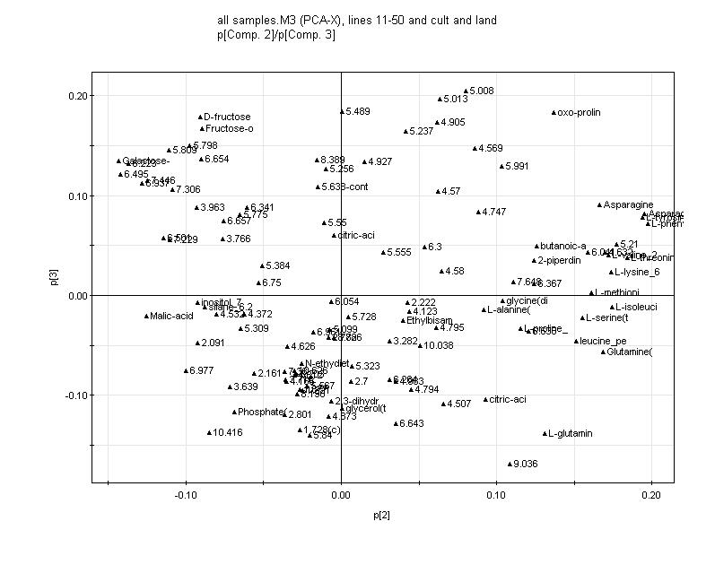
PCA Loadings Plot
Loadings plot shows how much each of the variables contributed to the different principal components
Variables at the extreme corners contribute most to the scores plot separation

Slide 65
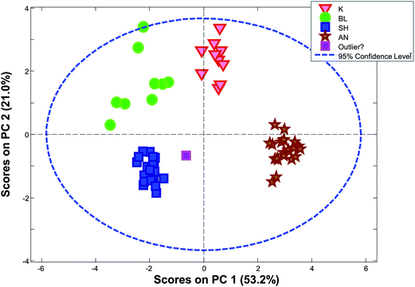
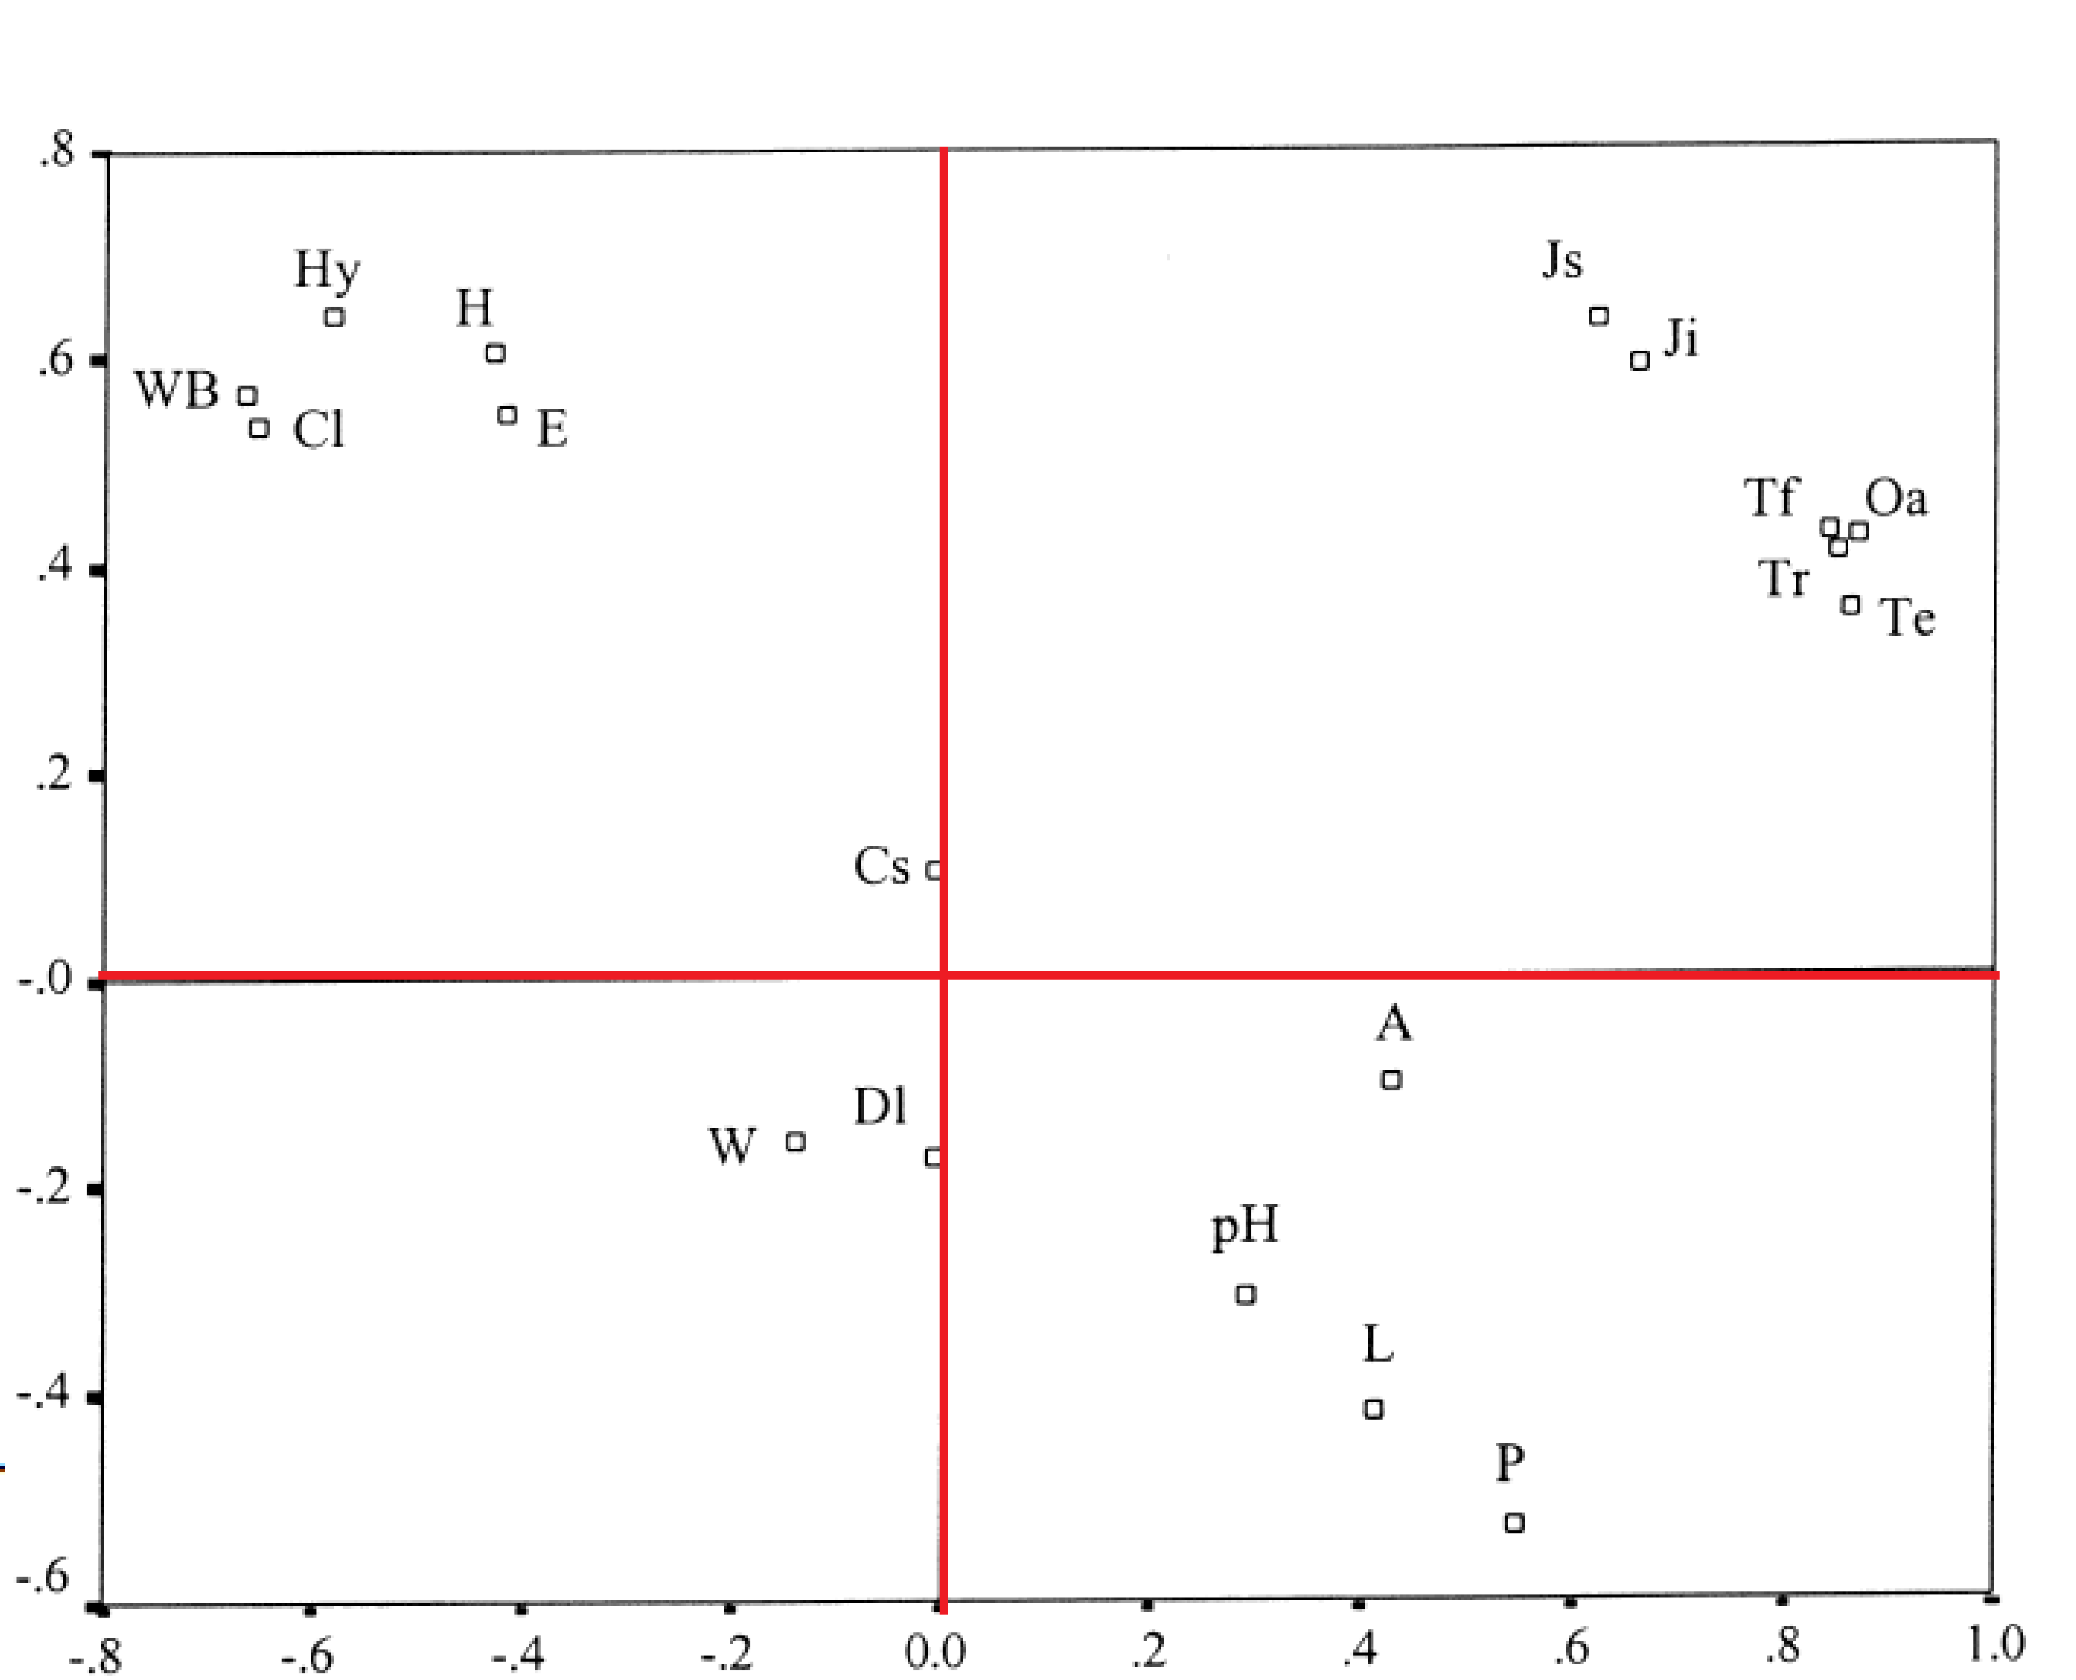
Scores & Loadings

Slide 66
PCA Summary
Rotates multivariate dataset into a new configuration which is easier to interpret
Purposes
Data overview
Outlier detection
Look at relationships between variables

Slide 67
PLS-DA
When the experimental effects are subtle or moderate, PCA will not show good separation patterns
PLS-DA is a supervised method, it is calculated by maximizing the co-variance between the data matrix (X) and the class labels (Y)
PLS-DA always produces certain separation patterns with regard the conditions

Slide 68
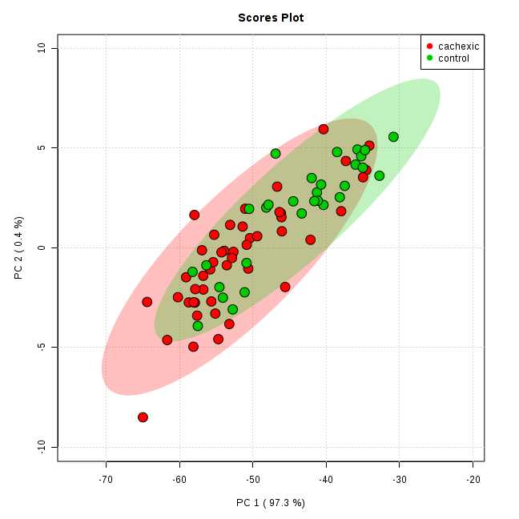
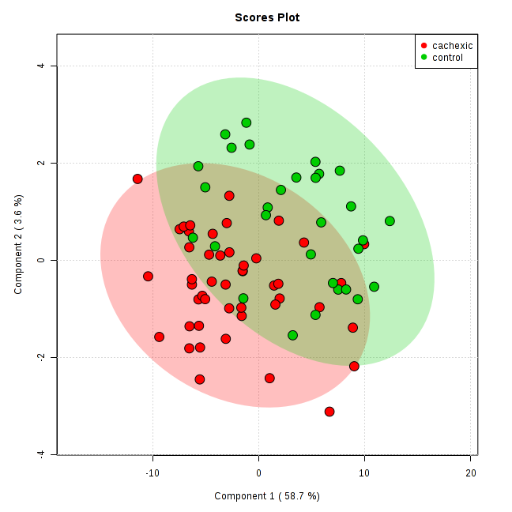
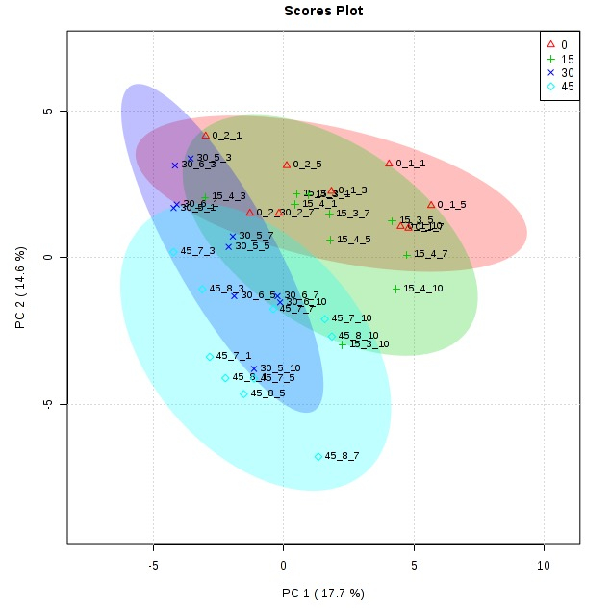
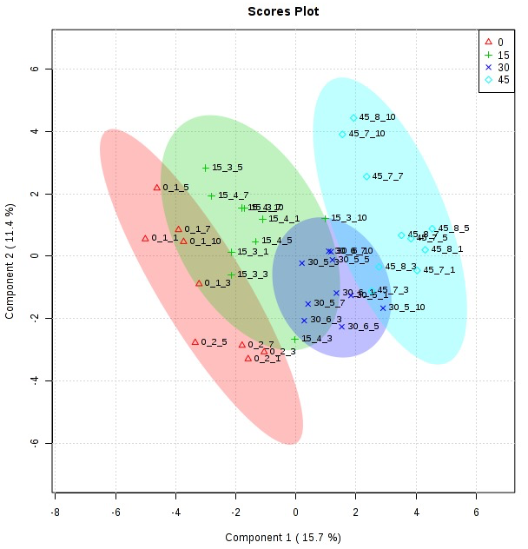
PCA vs. PLS-DA
➔
➔

Slide 69
Use PLS-DA with Caution
PLS-DA is susceptible to over-fitting by producing patterns of separation even for data randomly drawn from the same population
Need cross validation
Need permutation tests

Slide 70
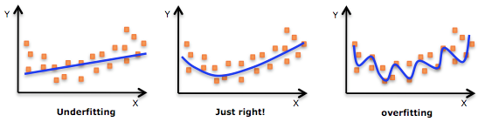
Overfitting
If we put too many variables in the model, including some unrelated to the response, we are overfitting.
Consequences are:
Fitted model is not good for prediction of new data – prediction error is underestimated
Model is too elaborate, models “noise” that will not be the same for new data

Slide 71
Cross Validations
Goal: test whether your model can predict class labels for new samples
Dataset
Train
Test

Slide 72
Common Splitting Strategies
Leave-one-out (n-fold cross validation)

Slide 73
Components and Features
Cross validation is used to determine the optimal number of components needed to build the PLS-DA model. Three common performance measures:
Sum of squares captured by the model (R²)
Cross-validated R² (also known as Q²)
Prediction accuracy

Slide 74
Permutation Tests
Goal: to test whether your model is significantly different from the null models
Randomly shuffle the class labels (y) and build the (null) model between new y and x;
Test whether there is still the similar distances of separation;
We can compute empirical p values
If the result is similar to the permuted results (i.e. null model), then we can NOT say y and x are significantly correlated

Slide 75
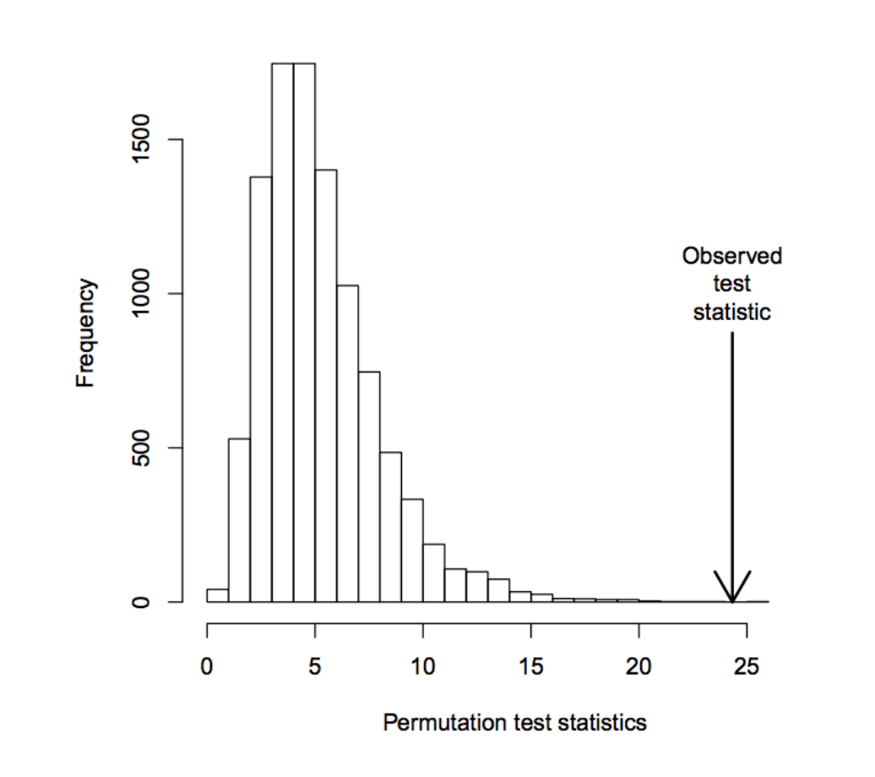
Compute Empirical P-values
In 1000 permutations, if none of the permuted models has a mean difference is bigger than the original one then:
p < 0.001 or (1/1001) # prevent p value equal to zero

Slide 76
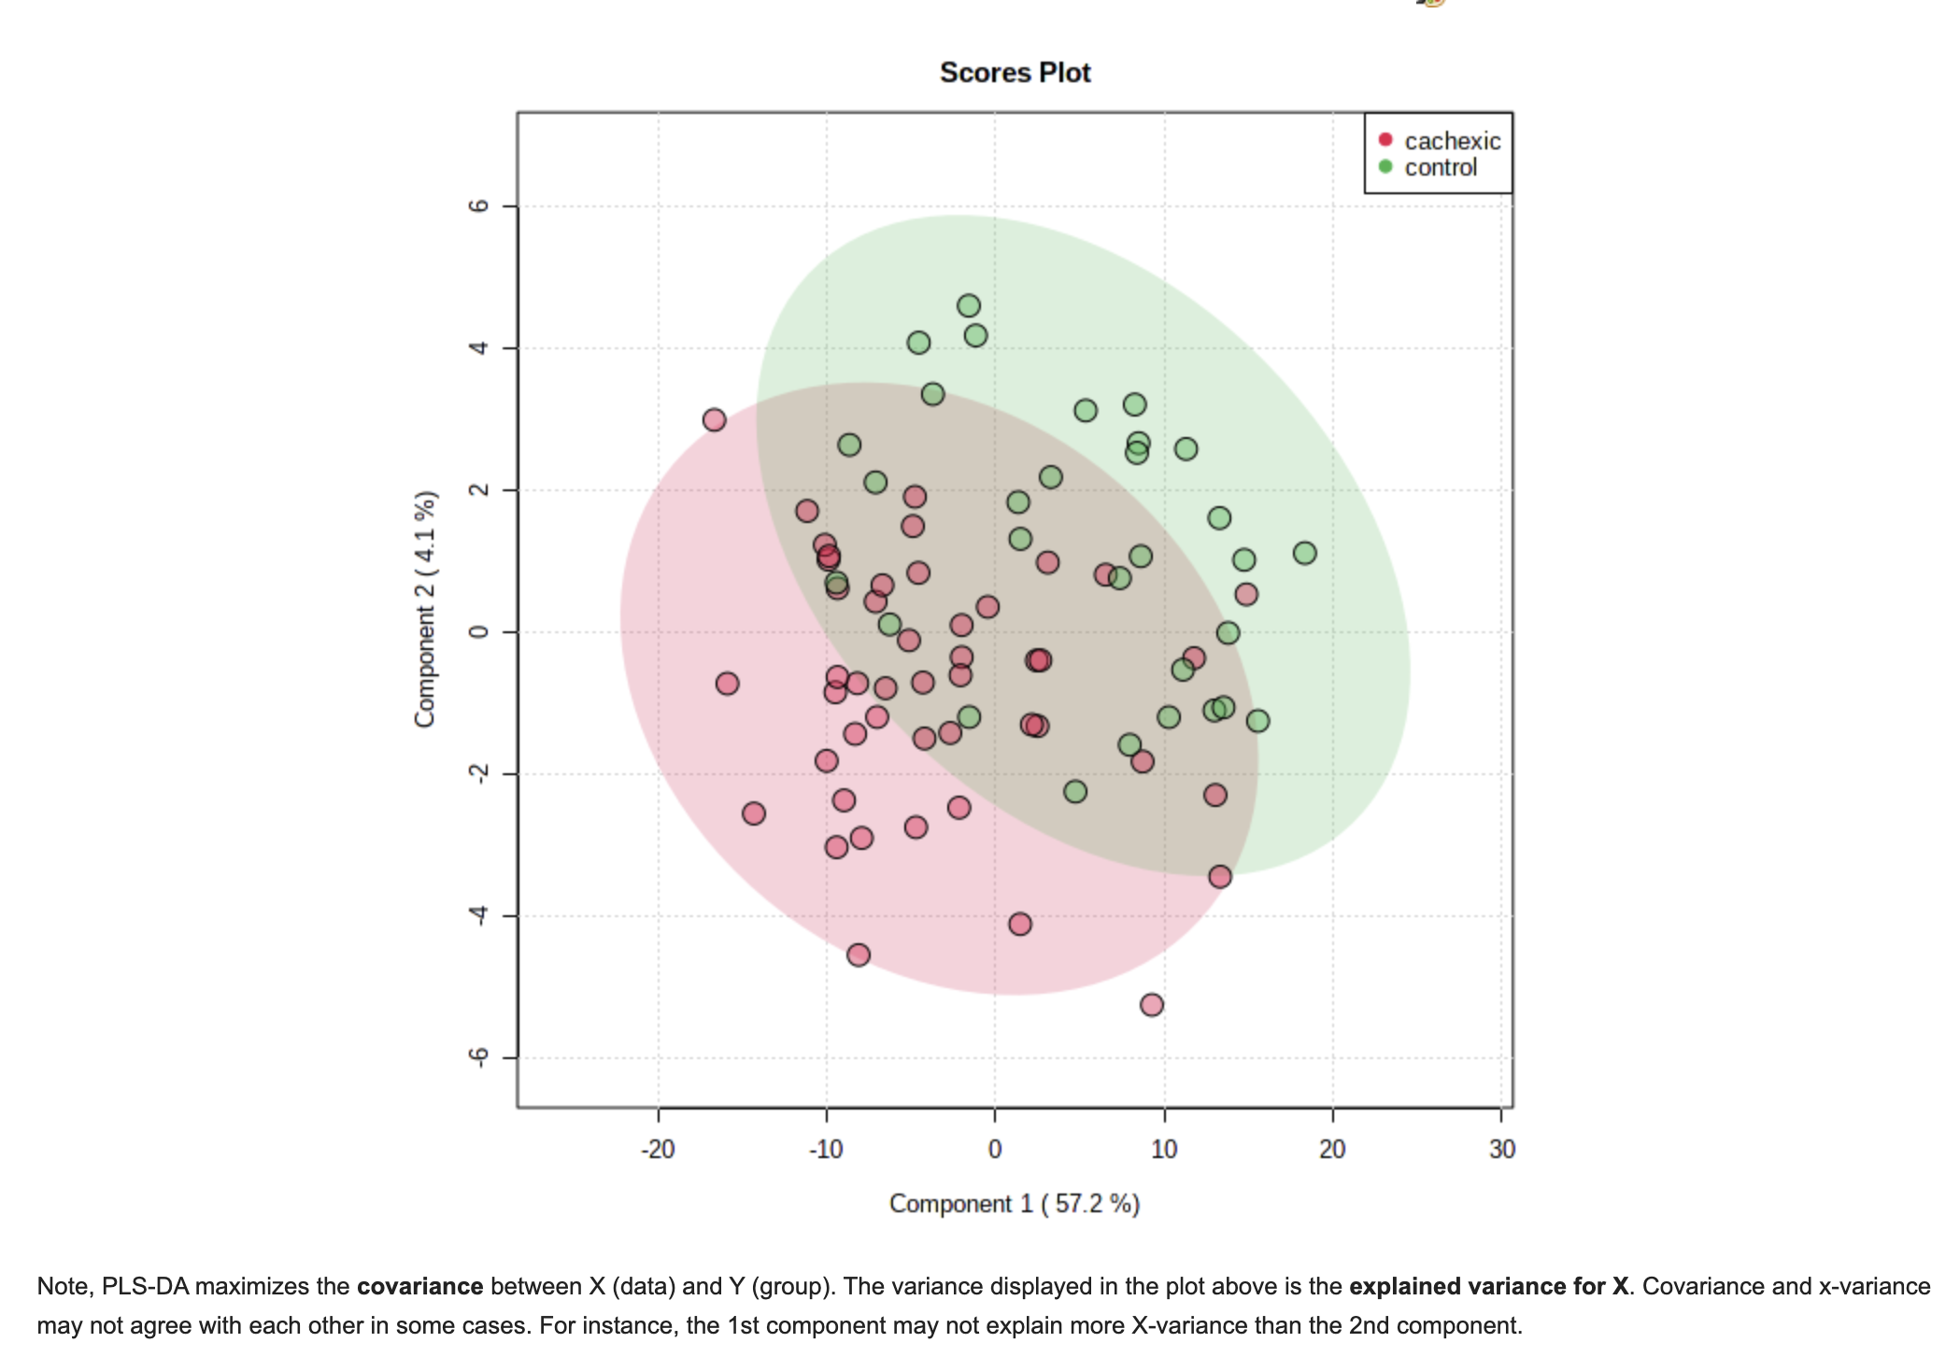
PLS-DA (Variance & Covariance)

Slide 77
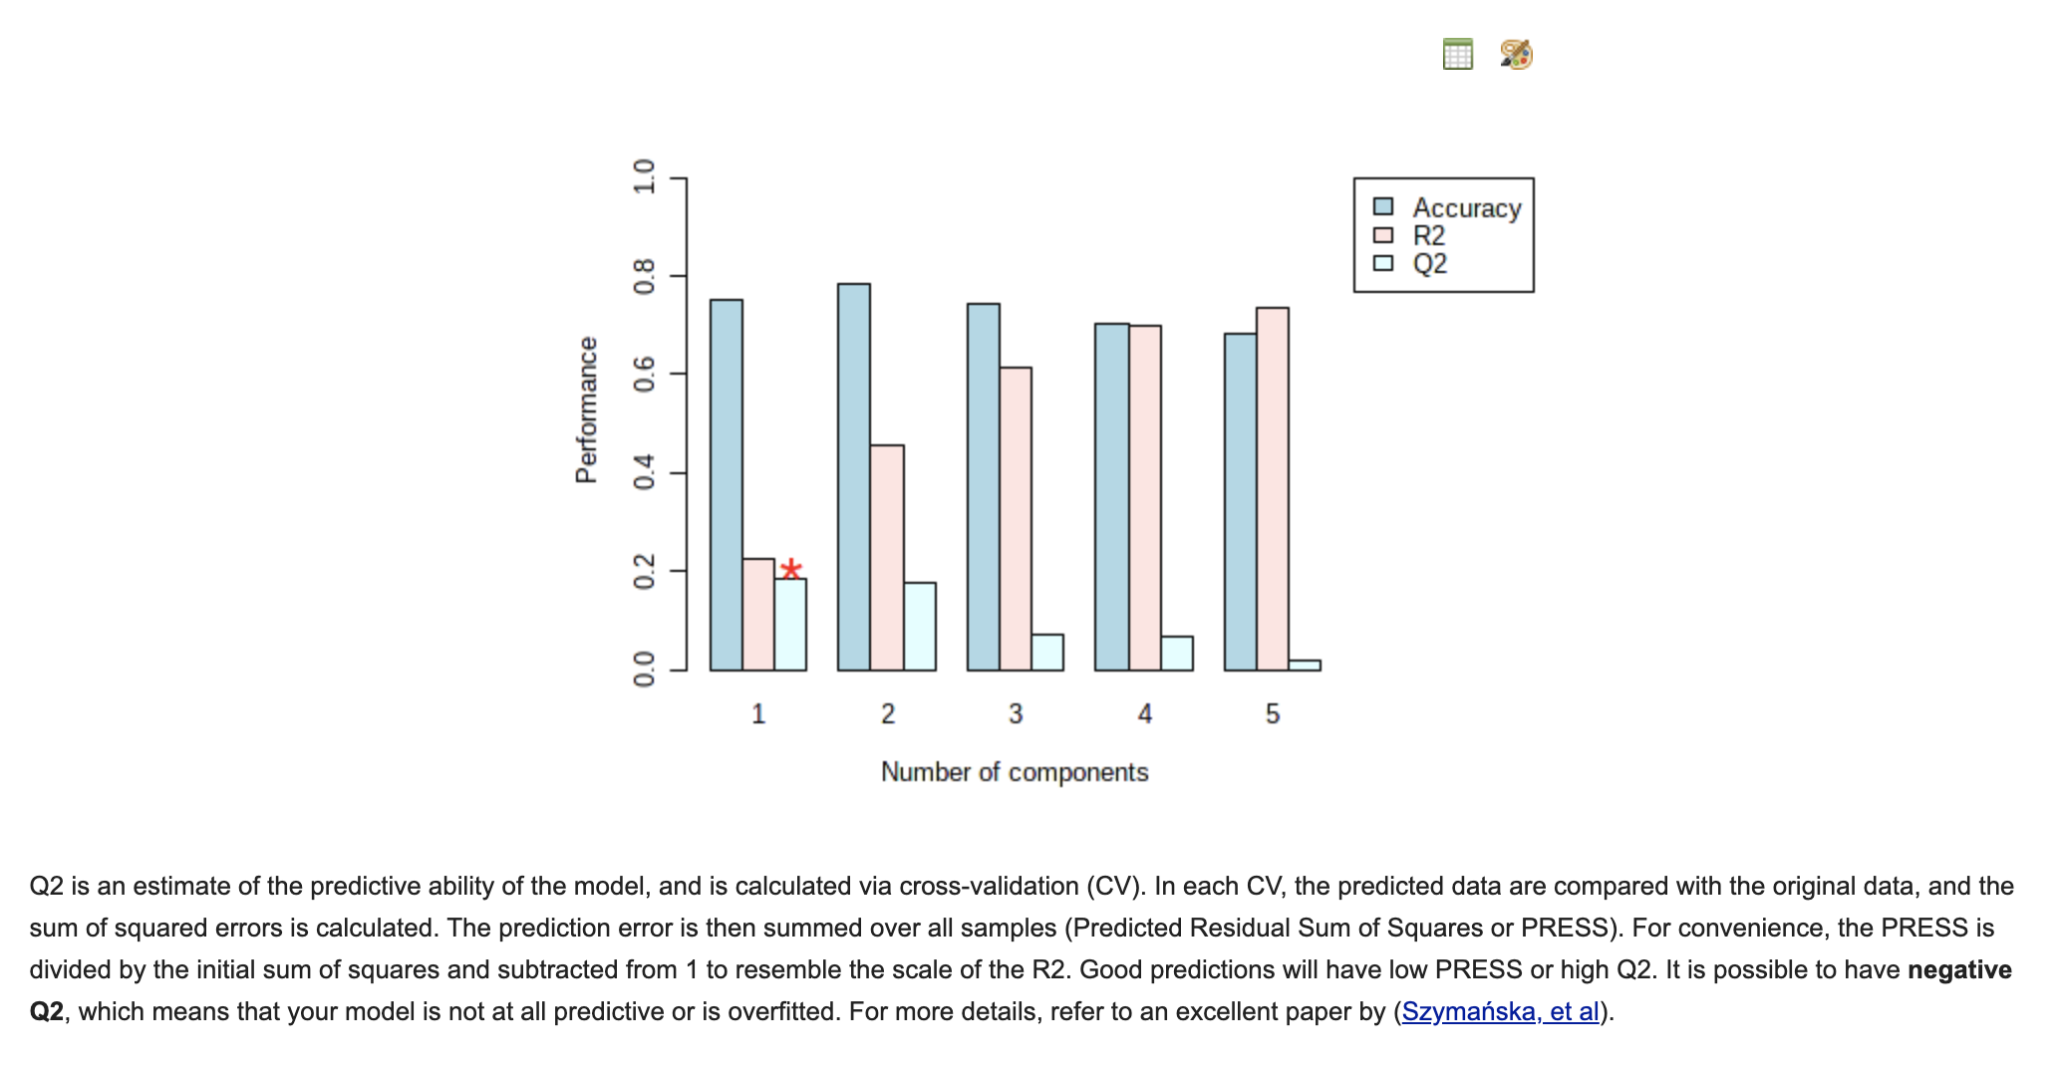
PLS-DA (R2 & Q2)

Slide 78
PLS-DA VIP Score
Variable Importance in Projection (VIP) scores estimate the importance of each variable in a PLS-DA model
Weighted sum of the squared correlations between the PLS-DA components and the original variable
Weights correspond to the percentage variation explained by the PLS-DA component in the model
VIP >1 can be considered important
VIP <1 is less important and might be a good candidate for exclusion from the model

Slide 79
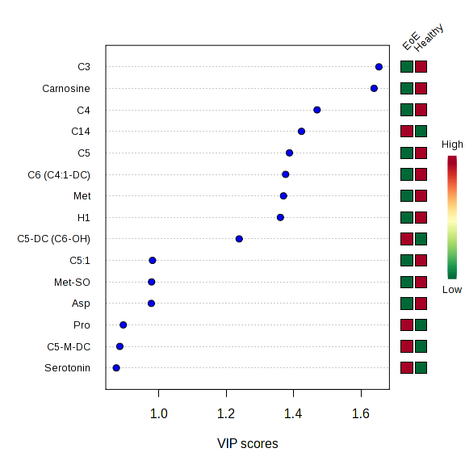
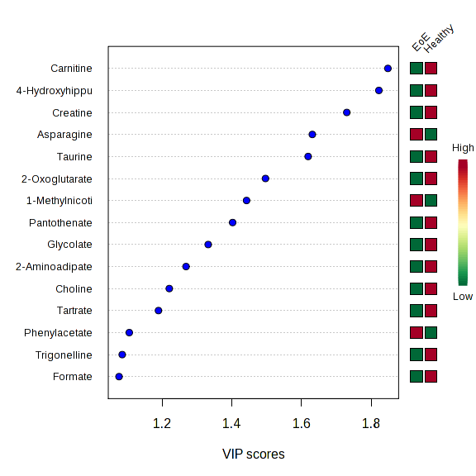
VIP Plots

Slide 80
Assessing Classification Model Performance
For balanced data
Accuracy: 9/13 correct => 69% accuracy
Error rate: 1 – accuracy => 31%
Not suitable for imbalanced data
In a population, cancer incidence is low: ~5 cases in 1000 people. If a classifier predict all people to be healthy, then it is 99.5% accurate (majority vote)

Slide 81
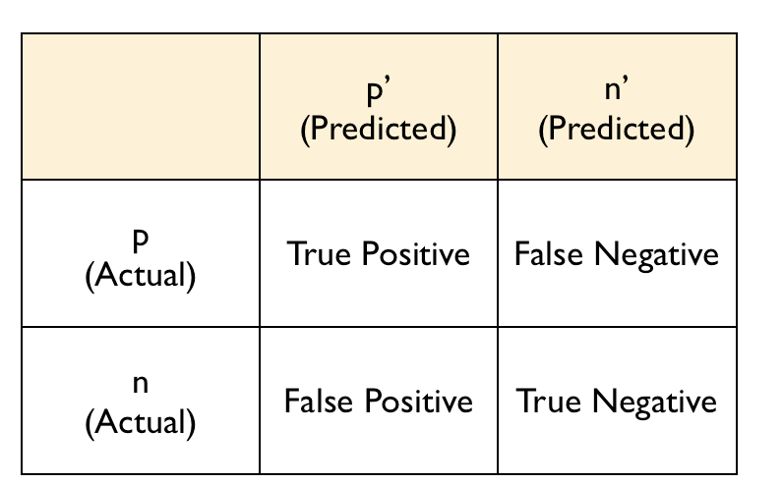
Evaluating Performance
Basic concepts
True positives (TP)
True negatives (TN)
False positives (FP)
False negatives (FN).
Sensitivity (Sn)
Specificity (Sp)
Sn (sensitivity) = True positive rate
Sp (specificity) = True negative rate

Slide 82
An Example
Call these patients “negative”
Call these patients “positive”
True Positives (TP)
True Negatives (TN)
False Negatives (FN)
False Positives (FP)
Test Results
Control
Disease
Sn = TP/(TP + FN) Sp = TN/(TN + FP)

Slide 83
ROC Curves
ROC = Receiver Operating Characteristic
A historic name from radar studies
Very popular in biomedical applications
To assess performance of classifiers.
To compare different biomarker models
A graphical plot of the true positive rate (TPR) vs. false positive rate (FPR), for a binary classifier (i.e. positive/negative) as its cutoff point is varied

Slide 84
ROC Curve
100%
Tradeoff between sensitivity and specificity
True Positive Rate (sensitivity)
0%
0%
False Positive Rate
(1-specificity)
100%

Slide 85
Area Under ROC Curve (AUC)
Overall measure of test performance
Comparisons between two tests based on differences between (estimated) AUC

Slide 86
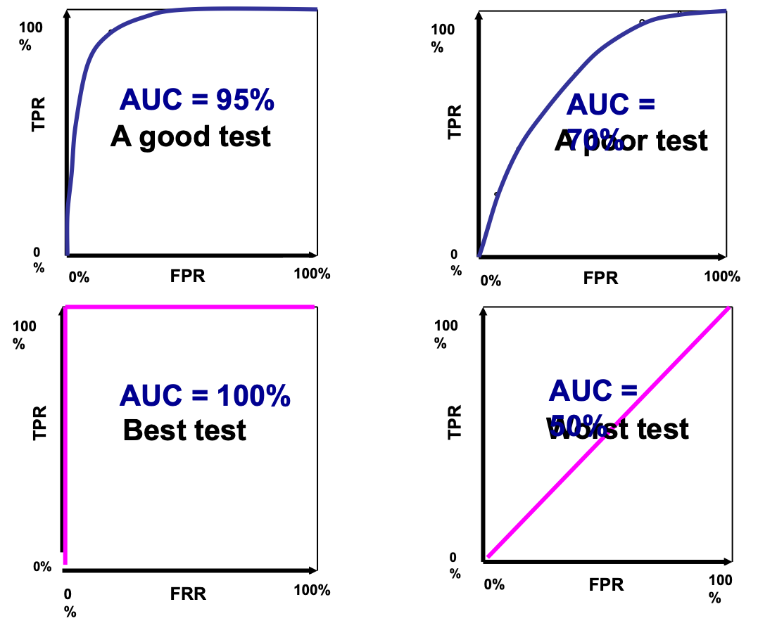
Area Under ROC Curve (AUC)

Slide 87
Other Supervised Classification Methods
SIMCA – Soft Independent Modeling of Class Analogy
*OPLS – Orthogonal Projection of Latent Structures
*Support Vector Machines
*Random Forest
* Implemented in MetaboAnalyst

Slide 88
Data Analysis Progression
Unsupervised Methods
PCA or cluster to see if natural clusters form or if data separates well
Data is “unlabeled” (no prior knowledge)
Supervised Methods/Machine Learning
Data is labeled (prior knowledge)
Used to see if data can be classified
Helps separate less obvious clusters or features
Statistical Significance
Supervised methods always generate clusters -- this can be very misleading
Check if clusters are real by label permutation

Slide 89
Note of Caution
Supervised classification methods are powerful
Learn from experience
Generalize from previous examples
Perform pattern recognition
Too many people skip the PCA or clustering steps and jump straight to supervised methods
Some get great separation and think the job is done - this is where the errors begin…
Too many don’t assess significance using permutation testing or cross validation
If separation isn’t partially obvious by eye-balling your data, you may be treading on thin ice

Slide 90

Don’t forget - Biology & Context
Statistics
Data Summary
Domain Knowledge
The Big Data
What we know
Visualization

